Slide 1

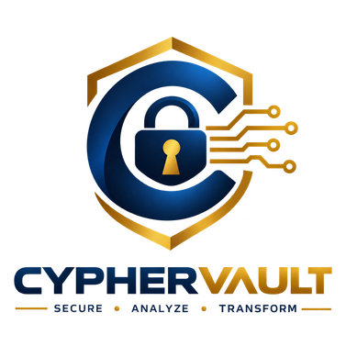


SMART INDIA HACKATHON 2026
CRYPTAGUARD
Problem Statement ID – SIH26164
Problem Statement Title – “Enterprise Cryptographic Discovery & Analysis Tool (ECDAT)”
Theme – Blockchain & Cybersecurity
PS Category – Software
Team ID – 138525
Team Name (Registered on portal) – Cypher Vault

Slide 2
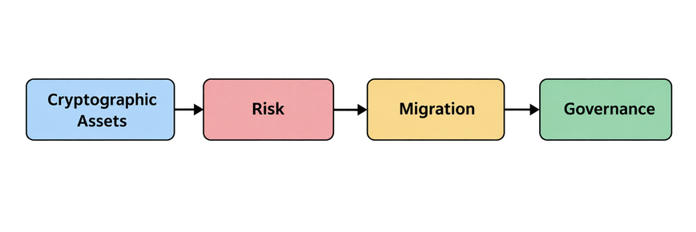
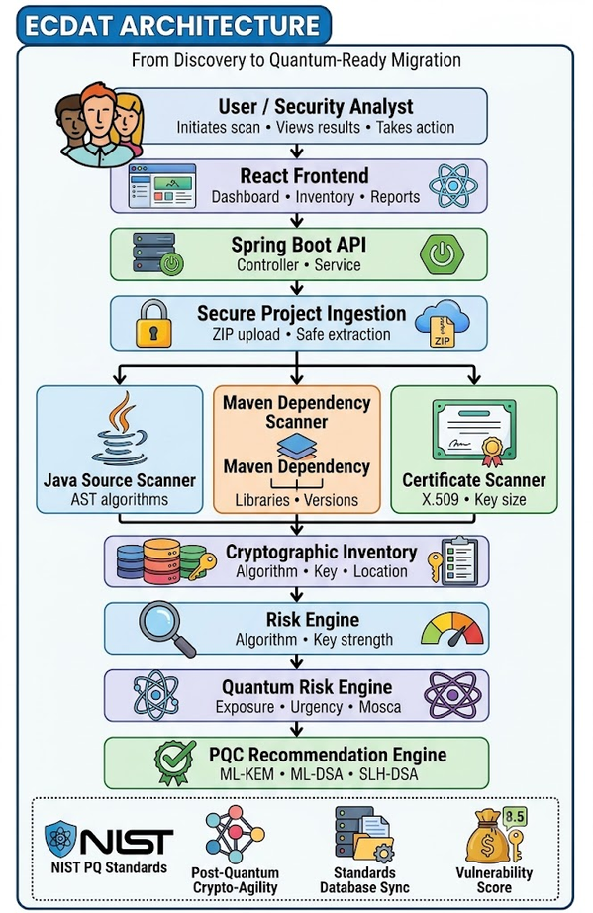
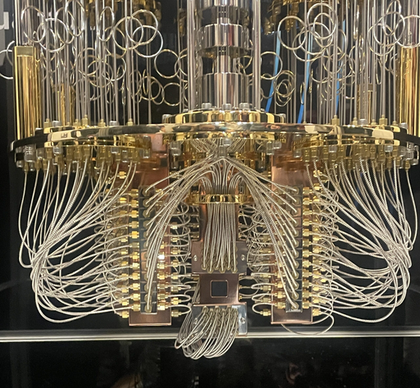
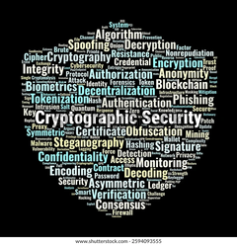

CRYPTAGUARD — Enterprise Cryptographic Security
Discover • Assess • Prioritize • Migrate
The Cryptographic Challenge
  Cryptographic assets can be found within the source code, libraries, certificates, configuration, binaries, and containers that modern businesses use in the organization.
  With quantum computing posing a threat to traditional public key cryptography, the organizations need to understand which of the assets are vulnerable and exposed.
ARCHITECTURE
CRYPTAGUARD
  CRYPTAGUARD delivers an end-to-end cryptographic discovery to migration decision framework.
  It conducts cryptographic discovery and inventorying, analysis using classical and quantum risk, priority migration based on cryptographic life time and Mosca analysis, and suggests appropriate PQC / hybrid solutions.
  All above deliverables connect in a migration roadmap and CBOM.
From Discovery to Decision
  Discover what cryptography exists.
  Understand what is at risk.
  Prioritize what needs to change.
  Identify the path toward PQC.
@SIH 2026

Slide 3
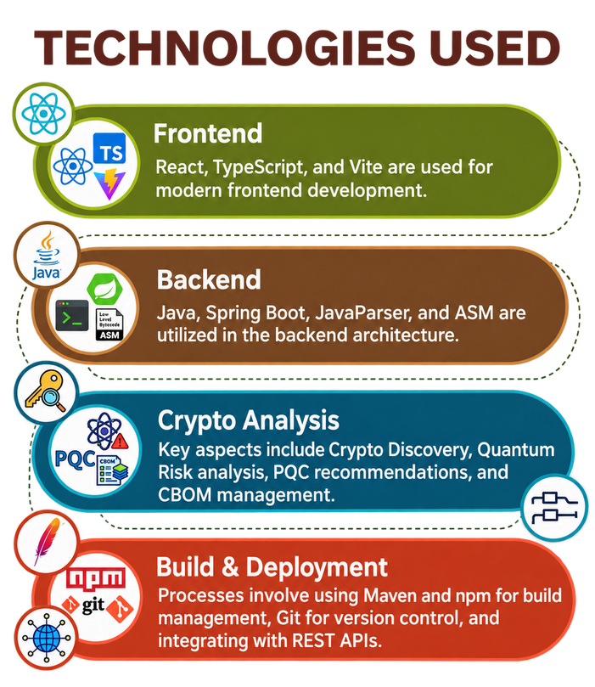




TECHNICAL APPROACH
TECHNOLOGY STACK
METHODOLOGY
01 — INPUT
Source repositories, archives, source code, binaries, configurations & certificates
02 — DISCOVER
Parse artefacts using AST, dependency, binary, configuration, certificate and container analysis
03 — INVENTORY
Normalize findings into a unified cryptographic inventory / CBOM with source evidence
05 — QUANTUM ANALYSIS
Assess quantum exposure using cryptographic lifetime, migration time and Mosca-style analysis
04 — ASSESS RISK
Analyze algorithm, purpose, key size, configuration, sensitivity, criticality and classical risk
06 — RECOMMEND
Generate context-aware PQC / hybrid migration recommendations and priorities
07 — OUTPUT
Interactive dashboard + reports + actionable CBOM
“The CRYPTAGUARD prototype works, allowing cryptographic discovery, inventory management, risk assessment against quantum attacks, PQC/hybrid recommendations, migration prioritization, and generation of CBOMs.”
@SIH 2026

Slide 4

FEASIBILITY AND VIABILITY
Technical Feasibility
Competitor Check
End-to-end prototype including discovery, inventory, risk analysis and migration advice.
Multi-method analysis based on source code, dependencies, configurations, certificates, binaries and containers.
Conclusion is supported by cryptographic use, location of source code and contextual risk data.
Flexible design allowing other scanning techniques, cryptographic policies and migration advice to be added.
Crypto Scanners → detect cryptography, limited migration context
SBOM Platforms → track components, limited crypto/quantum analysis
PQC Tools → recommend algorithms, limited asset discovery
Operational Viability
Challenge | Risk | Mitigation
Crypto Discovery | Fragmented & hidden assets | Multi-modal discovery + inventory
Quantum Threat | Exposure of vulnerable cryptography | Quantum + Mosca-based analysis
Mitigation Priority | Difficult to identify what comes first | Risk-based prioritization
PQC Selection | Unclear migration alternatives | PQC / Hybrid recommendations
Actionable workflow based on cryptographic discovery → quantum risk assessment → migration prioritization.
CBOM-enabled governance links cryptographic assets to risk, recommendation and migration.
Dashboard for interactive analysis, visualization and reporting of security teams.
Foundation for future enterprise integrations and extended cryptographic asset discovery.
@SIH 2026

Slide 5
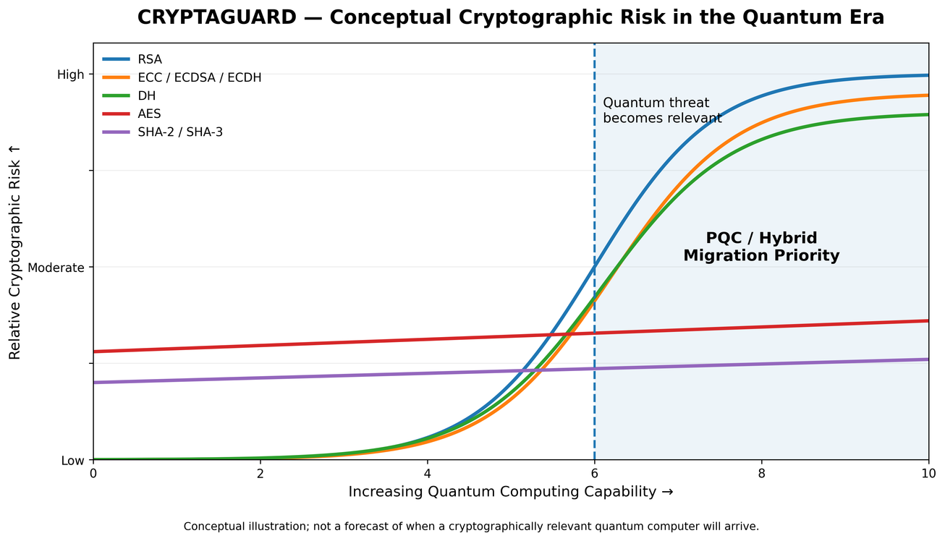
IMPACT AND BENEFITS
  Security & Quantum Readiness:
Ensures visibility for cryptography assets and quantum-vulnerable usage, aiding organizations in understanding the areas that require migration.
• Operational & Migration Efficiency
This transforms disparate pieces of information related to cryptography into a migration roadmap, allowing security professionals to focus on assets that need early evaluation and migration.
  Governance & Compliance Visibility
Creates a centralized cryptographic inventory and actionable CBOM, connecting assets, evidence, risk and recommended migration paths for security governance.
“As quantum capability advances, CRYPTAGUARD helps organizations move from cryptographic visibility to prioritized migration readiness.”
@SIH 2026

Slide 6
RESEARCH AND REFERENCES
RESEARCH FOUNDATION
• Cryptographic discovery and inventory are foundational for PQC migration, enabling organizations to identify where and how cryptography is used across their systems.
• Quantum-vulnerable public-key cryptography requires planned migration toward quantum-resistant alternatives, supported by risk assessment and prioritization.
• CRYPTAGUARD extends this approach by connecting discovery and inventory with quantum-risk analysis, migration prioritization and PQC/hybrid recommendations.
Primary Reference: NIST SP 1800-38B — Cryptographic Discovery NIST SP 1800-38B
SOLUTIONS ALREADY EXIST
OUR SOLUTION STANDS OUT
• Unified workflow: Discovery → Inventory → Risk → Migration → CBOM
• Multi-modal analysis: source code, dependencies, configurations, certificates, binaries and containers
• Quantum-focused assessment: combines cryptographic exposure, lifetime and Mosca-based analysis
IBM Quantum Safe Explorer — Cryptographic discovery, CBOM generation and migration prioritization.
IBM Guardium Cryptography Manager — Enterprise cryptographic inventory, risk assessment and lifecycle management.
Keyfactor AgileSec — Cryptographic asset discovery across code, infrastructure, networks and cloud.
You cannot secure what you cannot see — CRYPTAGUARD makes your cryptographic estate visible, measurable, and actionable.
@SIH 2026

